Slide 1
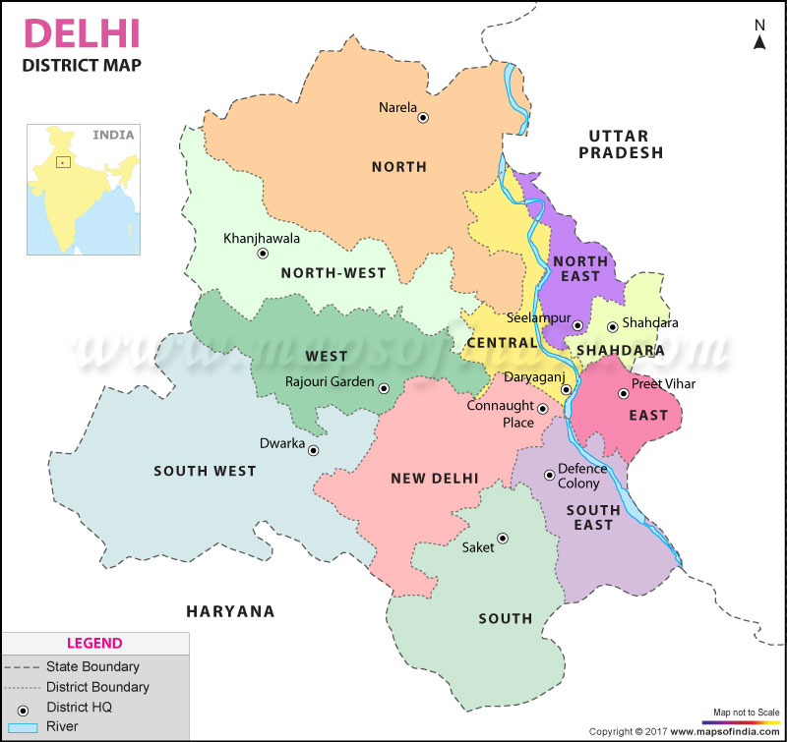
AIR POLLUTION IN DELHI & REPERCUSSIONS – AN ANALYSIS

Slide 2
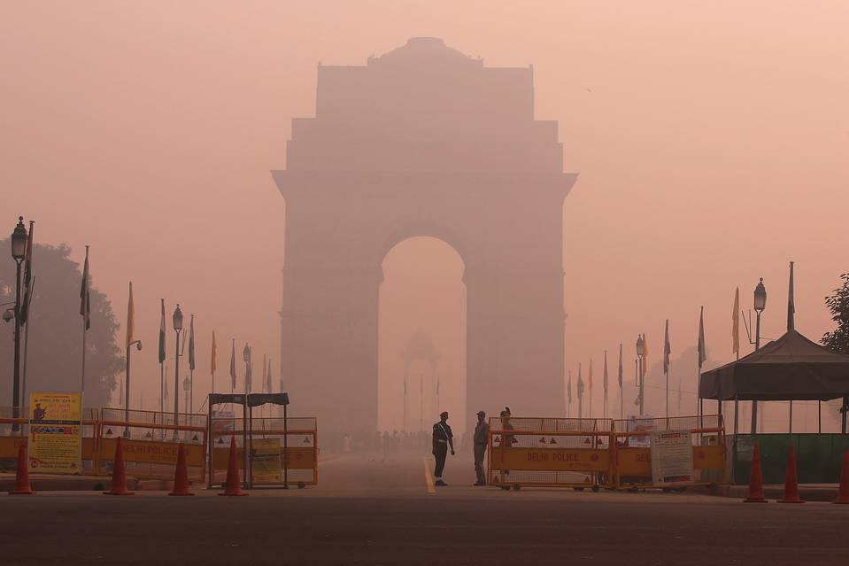
AIR POLLUTION IN DELHI
Air pollution can be defined as the presence of toxic chemicals or compounds (including those of biological origin) in the air, at levels that pose a health risk. In an even broader sense, air pollution means the presence of chemicals or compounds in the air which are usually not present and which lower the quality of the air or cause detrimental changes to the quality of life (such as the damaging of the ozone layer or causing global warming).

Slide 3
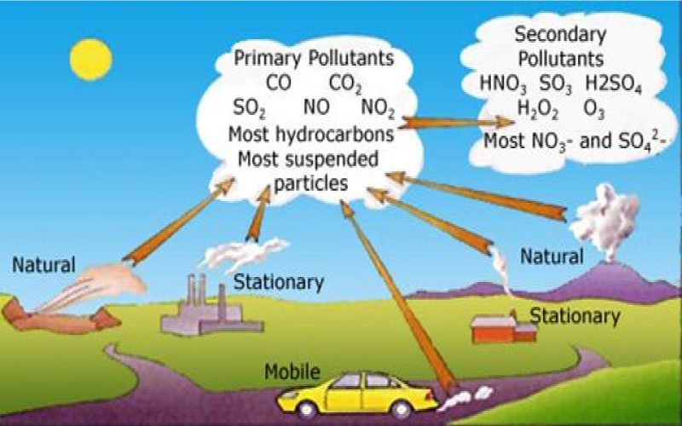
AIR POLLUTANTS
OZONE
NOX
SO2
BENZENE
TOLUENE
PM10
PM2.5

Slide 4
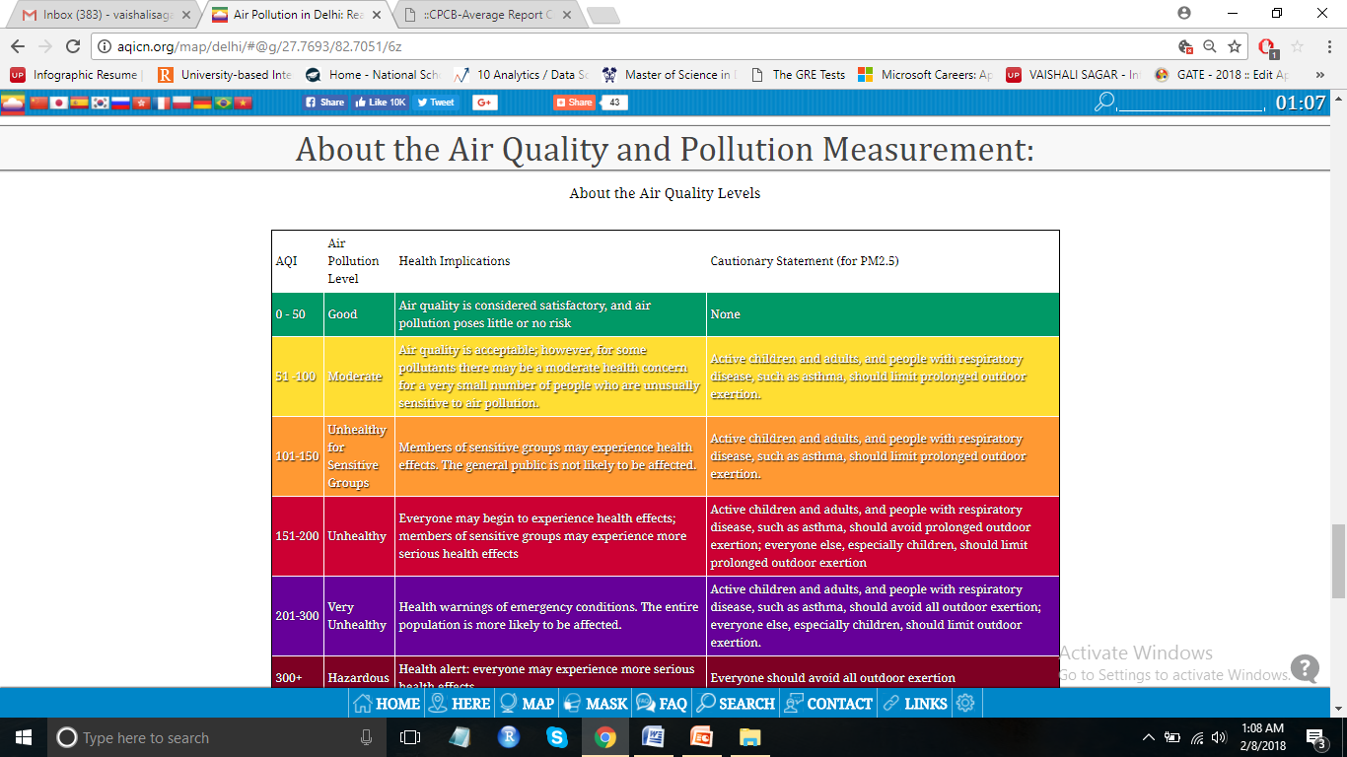
MONITORING STATIONS IN DELHI
Anand Vihar
R.K. Puram
Punjabi Bagh
Mandir Marg
Shahdipur
Dwarka
DTU
Pitampura
ITO
Sirifort
IHBAS
Gole Market
IGI airport
Civil Lines
Arjun Nagar
Mathura Road
Lodhi Road
Aya Nagar
North Campus
Pusa

Slide 5
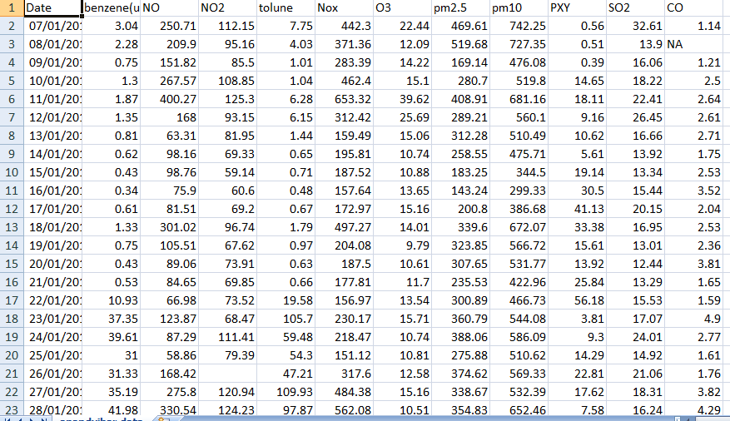
DATASET USED

Slide 6
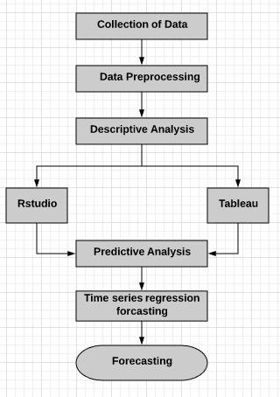
PROPOSED APPROACH

Slide 7
TECHNIQUES USED
1. Descriptive analysis
Descriptive analysis has been used in our study to describe the basic features of the data. Summaries about the sample and the measures have been observed through descriptive analysis. Together with simple graphics analysis, the basis of every quantitative analysis of data has been observed.
2. Predictive analysis
Predictive analytics is the use of data, statistical algorithms and machine learning techniques to identify the likelihood of future outcomes based on historical data. The goal is to predict the probable future through past experience. Similarly in our analysis, predictive analysis has been done by implementing time series regression forecasting.
3. Time series regression forecasting
Time series regression forecasting is used for analyzing time series data in order to study the behaviour of data with respect to time. This method involves the use of a model to forecast future values on the basis of previously observed values. Time series method is used in various applications like weather forecasting, earthquake prediction and trajectory forecasting and pattern recognition etc.

Slide 8
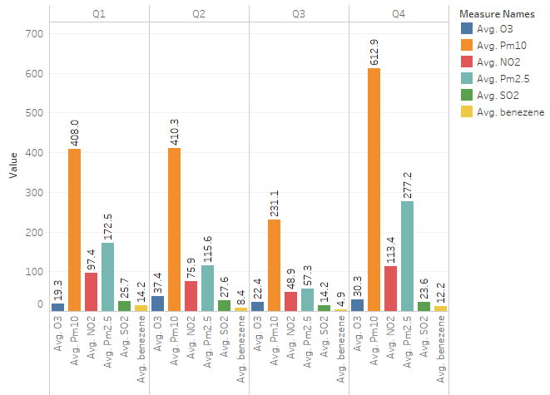
RESULTS

Slide 9
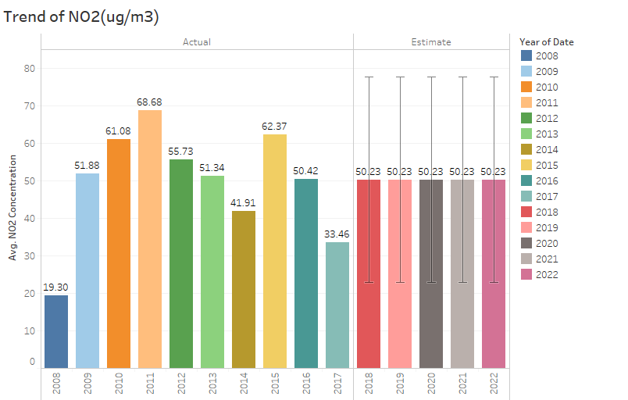

Slide 10
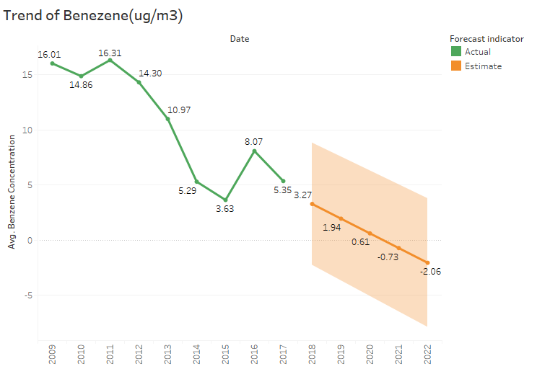

Slide 11
CONCLUSION
The agenda of work is to use technology for creating awareness to decrease pollution by adopting proper measures. New Delhi, which has already been ranked the world’s worst polluted city by the World Health Organization, is considered in the study. Anand Vihar and Shadipur areas having high population load were selected. In our study, we used time series regression forecasting, data mining techniques to fathom the different patterns in various types of pollutants. R studio platform and tableau have been used for predicting future pollution levels in Delhi using R language.
We have come to the conclusion that pollutants like NO_{x}, PM10, PM2.5 are likely to drastically increase in future, while SO₂ level may increase marginally in future. O₃ levels will increase in initial year .Though the amount of CO and Benzene are showing reducing trend. Increase in PM10, PM2.5 can be attributed to kerb-side dust and construction work. More stringent pollution control measures are required with public-policymakers participation. Emphasis to explore clean energy fuels and gradually phasing out fossil fuels, employing zero waste technology with integrated waste management will curb air pollution menace in due course .

Slide 12
THANK YOU

